Slide 1
Utrecht Summer School: Applied Text Mining
Ayoub Bagheri, a.bagheri@uu.nl
Berit Janssen, b.d.janssen@uu.nl
Dong Nguyen, d.p.nguyen@uu.nl

Slide 2

Text mining in an example
Garry works at Bol.com (a webshop in the Netherlands)
He works in the dep of Customer relationship management.
He reads customers’ reviews (comments), extracts aspects they wrote their reviews on, and identifies their sentiments.
Curious about his job? See two examples!

Slide 3

This is a nice book for both young and old. It gives beautiful life lessons in a fun way. Definitely worth the money! + Educational + Funny + Price
Nice story for older children.
+ Funny
- Readability

Slide 4

Example
Garry likes his job a lot, but sometimes it is frustrating!
This is mainly because their company is expanding quickly!
Garry decides to hire Larry as his assistant.

Slide 5

Example
Still, a lot to do for two people!
Garry has some budget to hire another assistant for couple of years!
He decides to hire Harry too!
Still, manual labeling is labor-intensive!

Slide 6
Challenges?
What are the challenges Garry, Larry, and Harry encounter in doing their job, when working with text data?
Go to www.menti.com and use the code 22 07 62 0

Slide 7
Challenges with text data
Huge amount of data
High dimensional but sparse
all possible word and phrase types in the language!!

Slide 8
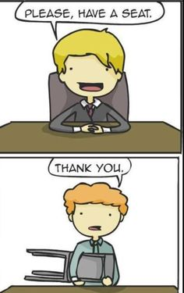
Challenges with text data
Ambiguity

Slide 9
Challenges with text data
Noisy data
Examples: Abbreviations, spelling errors, short text
Complex relationships between words
“Hema merges with Intertoys”
“Intertoys is bought by Hema”
Image from http://www.printwand.com/blog/8-catastrophic-examples-of-word-choice-mistakes

Slide 10

Example
During one of the coffee moments at the company, Garry was talking about their situation at the dep of Customer relationship management.
When Carrie, her colleague from the IT department, hears the situation, she offers Garry to use Text Mining!!
She continues : “Text mining is a subfield of AI and NLP and is related to data science, data mining and machine learning. It will make the process faster and cuts some of the expenses!”
Garry decides to give text mining a try!
I am not a scientist nor a teacher!

Slide 11


Example
Customer review
Recommendations
Text Mining system
Decisions

Slide 12
Text mining definition?
Which can be a part of Text Mining definition?
The discovery by computer of new, previously unknown information from textual data
Automatically extracting information from text
Text mining is about looking for patterns in text
Text mining describes a set of techniques that model and structure the information content of textual sources
(You can choose multiple choices)
Go to www.menti.com and use the code 22 07 62 0

Slide 13
Text mining definition
“the discovery by computer of new, previously unknown information, by automatically extracting information from different written resources” Hearst (1999)
Text mining is about looking for patterns in text, in a similar way that data mining can be loosely described as looking for patterns in data.
Text mining describes a set of linguistic, statistical, and machine learning techniques that model and structure the information content of textual sources. (Wikipedia)

Slide 14
Logistics

Slide 15
Access
You can view my screen on your machine:
join.me/TMPython
Access the course materials from:
www.ayoubbagheri.nl/TMPython

Slide 16
Program
Time | Monday | Tuesday | Wednesday | Thursday
09:00 – 10:30 | Lecture 1 | Lecture 3 | Lecture 5 | Lecture 7
 | Break | Break | Break | Break
10:45 – 11:45 | Practical 1 | Practical 3 | Practical 5 | Practical 7
11:45 – 12:30 | Discussion 1 | Discussion 3 | Discussion 5 | Discussion 7
12:30 – 14:00 | Lunch | Lunch | Lunch | Lunch
14:00 – 15:30 | Lecture 2 | Lecture 4 | Lecture 6 | Lecture 8
 | Break | Break | Break | Break
15:45 – 16:30 | Practical 2 | Practical 4 | Practical 6 | Practical 8
16:30 – 17:00 | Discussion 2 | Discussion 4 | Discussion 6 | Discussion 8

Slide 17
Goal of the course
The course teaches students the basic and advanced text mining techniques using Python on a variety of applications in many domains of science.

Slide 18
Python?
From 1 to 5 how familiar are you with Python?
Go to www.menti.com and use the code 81 09 57 8

Slide 19
Python IDE?
Which Python IDE do you mostly use?
Go to www.menti.com and use the code 81 09 57 8
From 1 to 10 how familiar are you with Google Colab?

Slide 20
Python
Latest: Python 3.9.1
Python For Beginners
https://www.python.org/about/gettingstarted/
The Python Language Reference
https://docs.python.org/3/reference/
Python 3.9.1 documentation
https://docs.python.org/3/

Slide 21
Google Colab
Colaboratory, or "Colab" for short, allows you to write and execute Python in your browser, with
Zero configuration required
Free access to GPUs
Easy sharing
https://colab.research.google.com/notebooks/intro.ipynb

Slide 22
Google Colab?
From 1 to 5 how familiar are you with Google Colab?
Go to www.menti.com and use the code 81 09 57 8

Slide 23
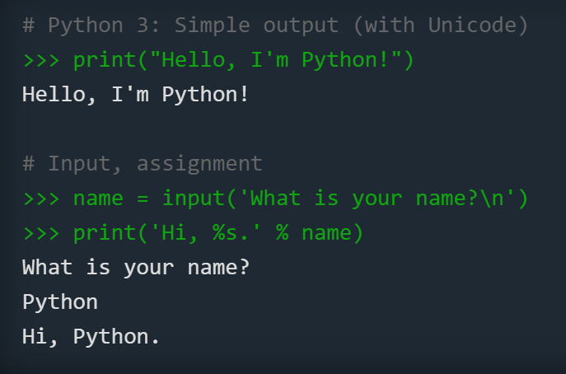
Python: Quick & Easy to Learn
Code in Colab
https://www.python.org/

Slide 24
Python: Quick & Easy to Learn
Code in Colab
https://www.python.org/

Slide 25
Do you have any questions?
During the lecture
Post your question to the chat; we will read them during a break.
During the computer lab
Post your question in general; we will answer them.
After the lecture
Feel free to send me an email or text me in Microsoft Teams

Slide 26
continue Introduction
Ayoub Bagheri, a.bagheri@uu.nl
Utrecht Summer School: Applied Text Mining

Slide 27
Another TM definition
Text Mining = Data Mining + Text Data
Emails
Scientific literature
Clinical letters
Information retrieval
Tweets
Natural language processing
Software documentations
Applied machine learning
Web pages
News articles

Slide 28
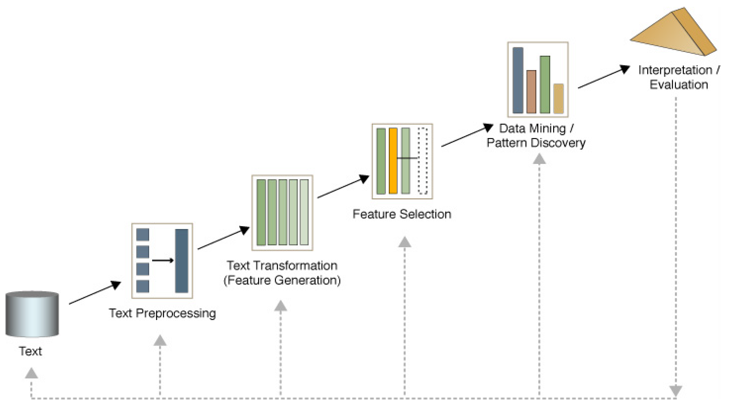
Text mining process

Slide 29
Text mining tools
Text classification
Text clustering
We will also cover:
Sentiment analysis
Feature selection
Topic modelling
Word embedding
Deep learning models
Responsible text mining
Text summarization

Slide 30
Text classification
Supervised learning
Human experts annotate a set of text data
Training set
Learn a classification model
Document | Class
Email1 | Not spam
Email2 | Not spam
Email3 | Spam
… | …

Slide 31
Text classification?
Which problem is not a text classification task? (less likely to be)
Author's gender detection from text
Finding about the smoking conditions of patients from clinical letters
Grouping news articles into political vs non-political news
Classifying reviews into positive and negative sentiment
Go to www.menti.com and use the code 86 08 86 5

Slide 32
Text clustering
Unsupervised learning
Finding Groups of Similar Documents
No labeled data
Document | Cluster
News article1 | ?
News article2 | ?
News article3 | ?
… | …

Slide 33
Text clustering?
Which problem is not a text clustering task? (less likely to be)
Grouping similar news articles
Grouping discharge letters in two categories: heart disease vs cancer
Grouping tweets which support Trump into three undefined subgroups
Grouping online books of a library in 10 categories
Go to www.menti.com and use the code 86 08 86 5

Slide 34
Text preprocessing

Slide 35
Feature extraction

Slide 36
Visualisation

Slide 37
Other examples (from different disciplines)
SALTClass
ICD Classification
ASReview

Slide 38

Practical 1

Slide 39
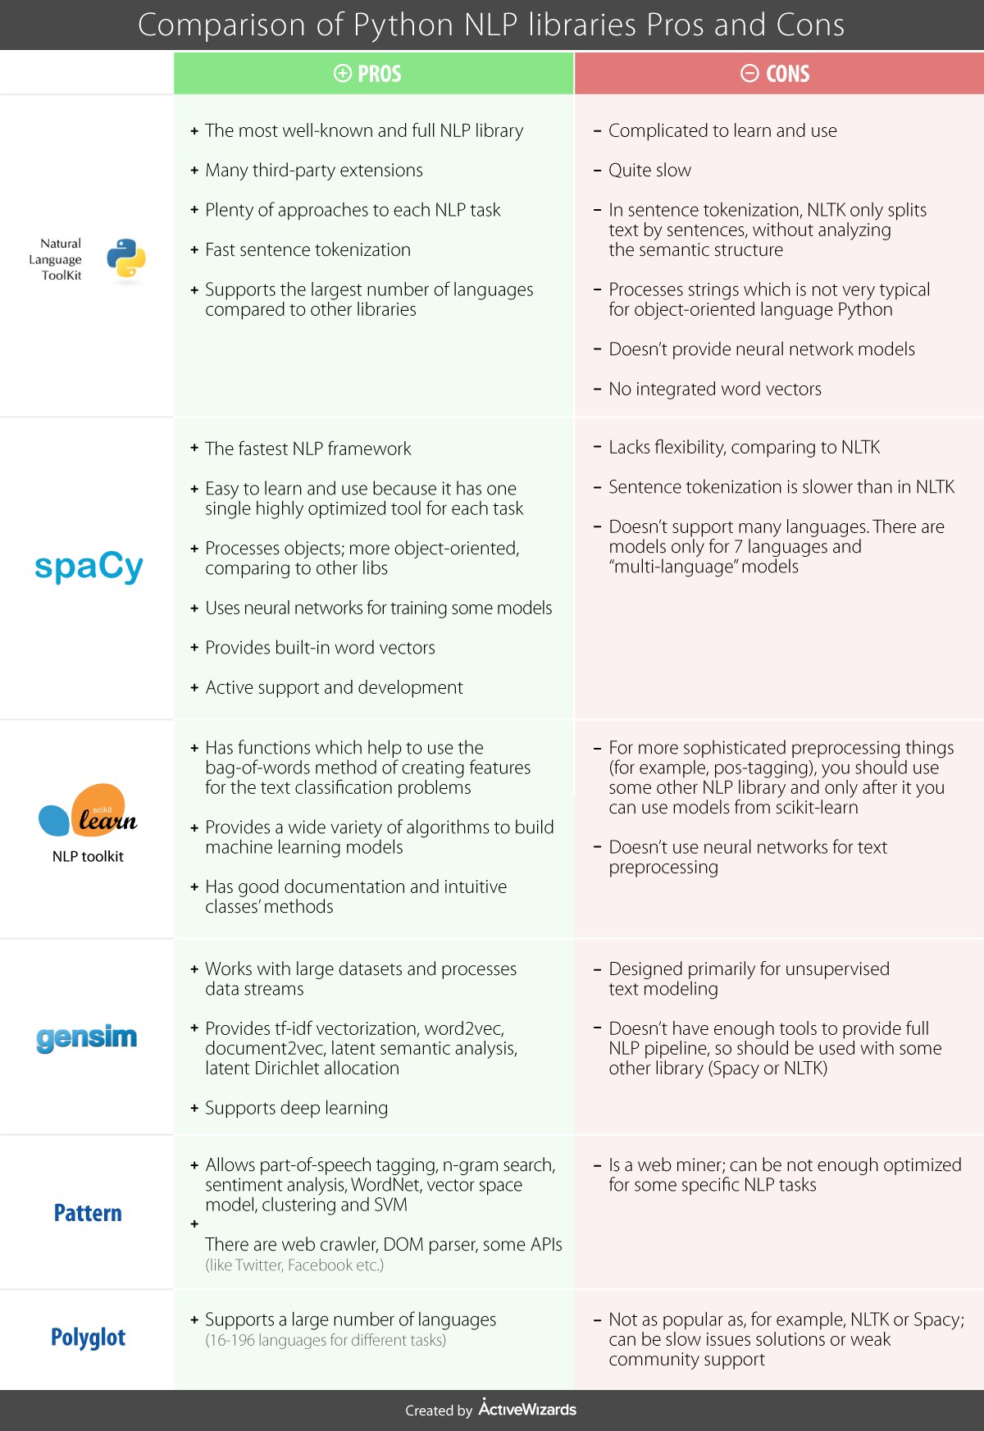
Source: https://activewizards.com/blog/comparison-of-python-nlp-libraries/

Slide 40
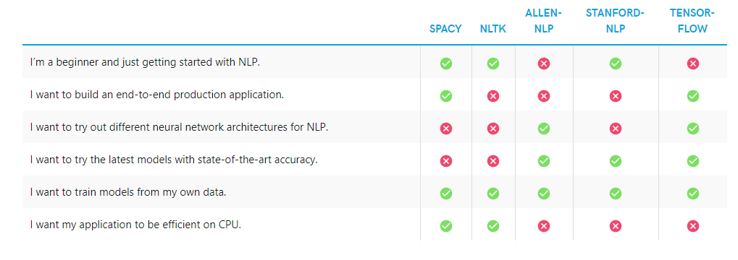
Source: https://soshace.com/overview-of-natural-language-processing-using-python-libraries/

